Slide 1
CSE 391: Programming for the Internet
M. Abdur Rahman
Acknowledgment:
The slides are of ones by Dr. Russell Martin.
http://www.csc.liv.ac.uk/~martin/teaching/comp519

Slide 2
Hypertext & HTML
HyperText Markup Language (HTML) is the language for specifying the static content of Web pages (based on SGML, the Standard Generalized Markup Language)
  hypertext refers to the fact that Web pages are more than just text
    can contain multimedia, provide links for jumping within the same document & to other documents
  markup refers to the fact that it works by augmenting text with special symbols (tags) that identify the document structure and content type

Slide 3
Hypertext & HTML (cont.)
HTML is an evolving standard (as new technology/tools are added)
    HTML 1 (Berners-Lee, 1989): very basic, limited integration of multimedia
      in 1993, Mosaic added many new features (e.g., integrated images)
    HTML 2.0 (IETF, 1994): tried to standardize these & other features, but late
      in 1994-96, Netscape & IE added many new, divergent features
    HTML 3.2 (W3C, 1996): attempted to unify into a single standard
      but didn't address newer technologies like Java applets & streaming video
    HTML 4.0 (W3C, 1997): current standard (but moving towards XHTML)
      attempted to map out future directions for HTML, not just react to vendors
    XHTML 1.0 (W3C, 2000): HTML 4.01 modified to conform to XML standards
    XHTML 1.1 (W3C, 2001): “Modularization” of XHTML 1.0
    HTML 5 (Web Hypertext Application Technology Working Group, W3C, 2006): New
    version of HTML4, XHTML 1.0, and DOM 2 (still a work in progress), no longer
    based on SGML, but “backward compatible” with parsing of older versions of
    HTML. HTML 5 is referred to as a "living language".

Slide 4
In this course…
You should design your webpages to the XHTML 1.0 Strict standard (or better).
I will be enforcing this standard in your assessments (as much as possible).
More will be said when I discuss Document Type Declarations (soon).

Slide 5
Web Development Tools
many high-level tools exist for creating Web pages
  e.g., Microsoft FrontPage, Netscape Composer, Adobe PageMill,
  Macromedia DreamWeaver, HotDog, …
  also, many applications have "save to HTML" options (e.g., Word)
  Don’t use these tools!!
  for most users who want to develop basic, static Web pages, these are fine (but many of these programs produce very poorly structured HTML code)
why are we learning low-level HTML using a basic text editor?
  may want low-level control
  may care about size/readability of pages
  may want to “borrow" components from other pages and integrate into existing pages
  may want dynamic features such as scripts or applets
  remote editing of web pages may only be possible using a basic text editor
  sticking to (internationally and industrially) agreed upon standards will help ensure your web documents are rendered as you intend them to look and operate as you desire

Slide 6
Tags and Elements
HTML specifies a set of tags that identify structure of the document and the content type
  tags are enclosed in < >
    <img src="image.gif" /> specifies an image
  most tags come in pairs, marking a beginning and ending
    <title> and </title> enclose the title of a page
an HTML element is an object enclosed by a pair (in most cases) of tags
    <title>My Home Page</title> is a TITLE element
    <b>This text appears bold.</b> is a BOLD element
    <p>Part of this text is <b>bold</b>. </p>
        is a PARAGRAPH element that contains a BOLD element
An HTML document is a collection of elements (text/media with context).

Slide 7
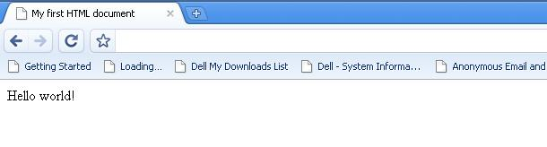
Structural Elements
an HTML document has two main structural elements
  HEAD contains setup information for the browser & the Web page
    e.g., the title for the browser window, style definitions, JavaScript code, …
  BODY contains the actual content to be displayed in the Web page
<html>
<!–- Version information --
-- File: page01.html --
-- Author: BRACU --
-- Creation: 15.08.09 --
-- Description: introductory page --
-- Copyright: BRACU --
-->
<head>
<title>My first HTML document</title>
</head>
<body>
Hello world!
</body>
</html>
HTML documents begin and end with <html> and </html> tags
Comments appear between <!-- and -->
HEAD section enclosed between <head> and </head>
BODY section enclosed between <body> and </body>
* Find more info on HTML docs!

Slide 8
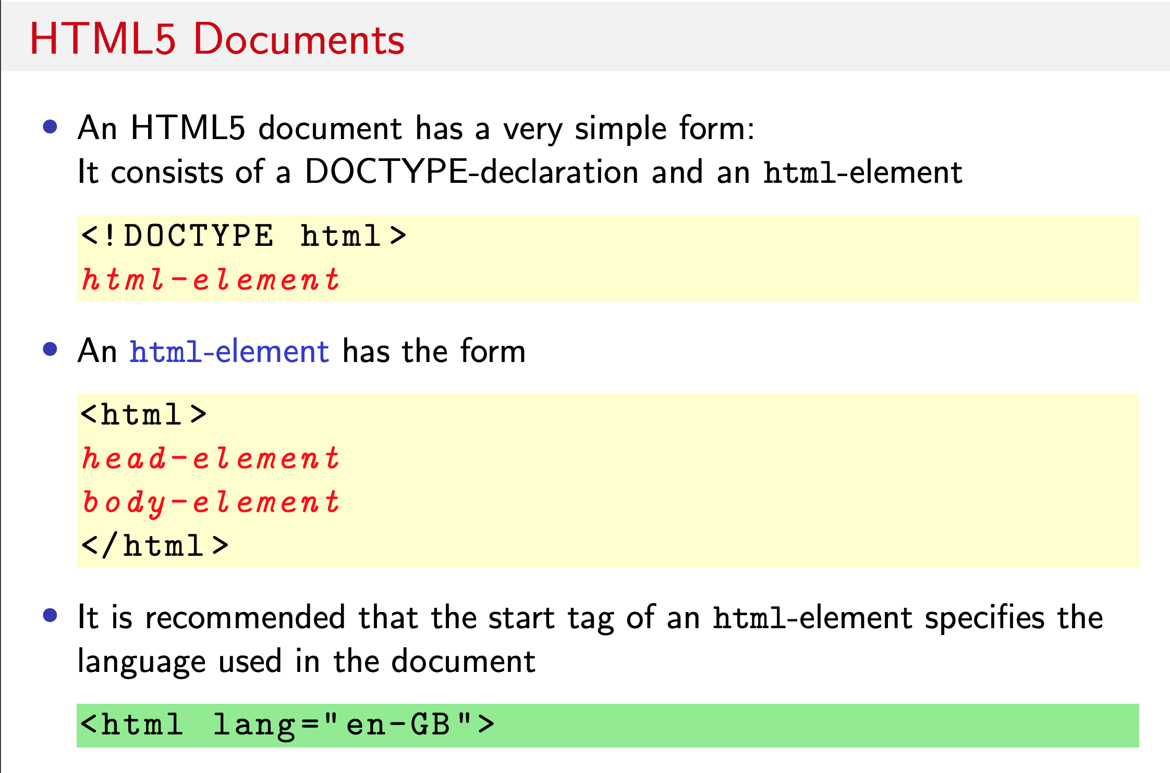

Slide 9
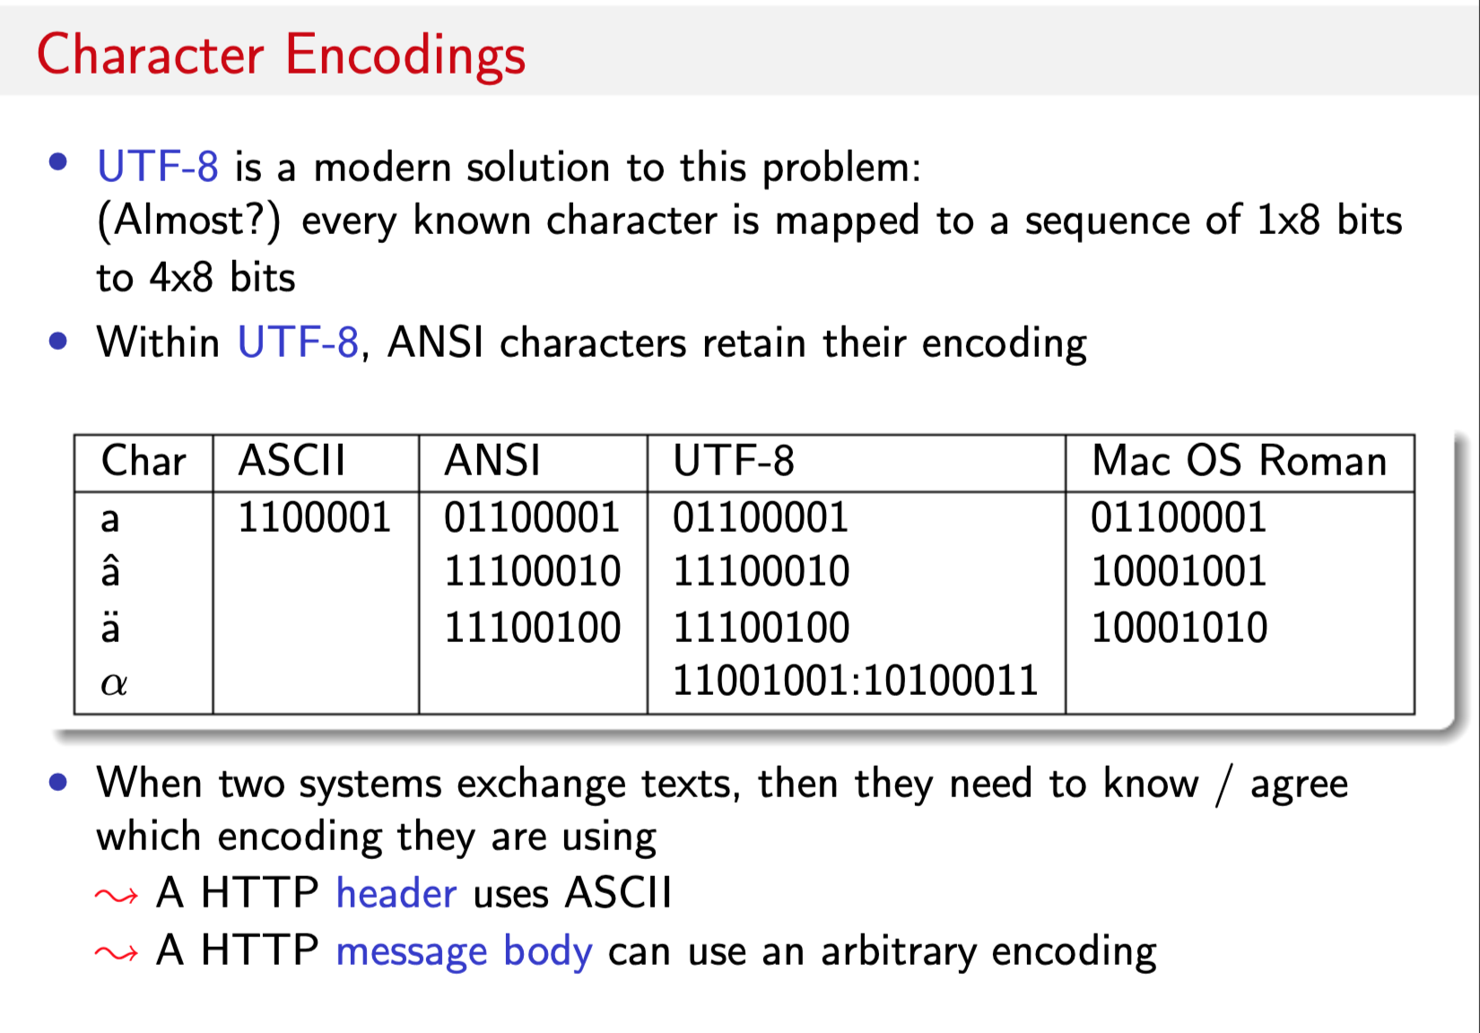

Slide 10
Text Layout
<html>
<head>
<title>Text Layout</title>
</head>
<body>
<p>
This is a paragraph of text<br/>
made up of two lines.
</p>
<p>
This is another paragraph with a
&nbsp; GAP &nbsp; between
some of the words.
</p>
<p>
&nbsp;&nbsp; This paragraph is<br/>
indented on the first line<br/>
but not on subsequent lines.
</p>
</body>
</html>
for the most part, layout of the text must be left to the browser
  every sequence of whitespace is interpreted as a single space
  browser automatically wraps the text to fit the window size
can override some text layout
  can cause a line break using the <br/> tag (no closing tag)
  can specify a new paragraph (starts on a new line, preceded by a blank line) using <p>…</p>
  can force a space character using the symbol for a non-breaking space: &nbsp;

Slide 11
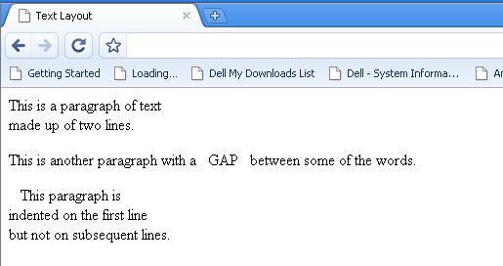
Text Layout

Slide 12
Separating Blocks of Text
<html>
<head>
<title>Blocks of Text</title>
</head>
<body>
<h1>Major heading 1</h1>
<p>
Here is some text.
</p>
<h2>Subheading</h2>
<p>
Here is some subtext.
</p>
<hr/>
<h1>Major heading 2</h1>
<p>
Here is some more text.
</p>
</body>
</html>
can specify headings for paragraphs or blocks of text
  <h1>…</h1> tags produce a large, bold heading
  <h2>…</h2> tags produce a slightly smaller heading
    . . .
  <h6>…</h6> tags produce a tiny heading
can insert a horizontal rule to divide sections
  <hr/> draws line across window

Slide 13
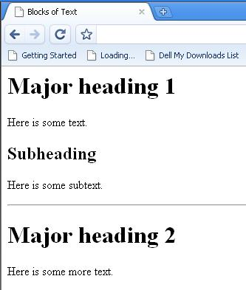
Separating Blocks of Text

Slide 14
The Basic Web page – A Worked Example
<html>
<head>
<title> Bill Smiggins Inc. </title>
</head>
<body>
<h1>Bill Smiggins Inc.</h1>
<h2>About our Company...</h2>
<p>This Web site provides clients, customers,
interested parties and our staff with all of
the information that they could want on
our products, services, success and failures.
</p>
<hr/>
<h3> Products </h3>
<p> We are probably the largest
supplier of custom widgets, thingummybobs, and bits
and pieces in North America. </p>
<hr/>
</body>
</html>
view page

Slide 15
Text Appearance
<html>
<head>
<title>Text Variations and Escape Sequences</title>
</head>
<body>
<h1>Text Variations</h1>
<p>We can use <b>simple</b> tags to
<i>change</i> the appearance of
<strong>text</strong> within
<tt>Web pages</tt>.
Even super<sup>script</sup>
and sub<sub>scripts</sub> are
<em>supported</em>.</p>
<h1>Text Escape Sequences</h1>
<p>
&amp; &lt; &gt; &quot; &copy;
</p>
<h1>Preformatted text</h1>
<pre>
BRAC University
Department of Computer Science
CSE391: Programming For Internet :) </pre>
</body>
</html>
can specify styles for fonts
  <b>… </b> specify bold
  <i>… </i> specify italics
  <tt>… </tt> specify typewriter-like (fixed-width) font
  <big>… </big> increase the size of the font
  <small>… </small> decrease the size of the font
  <em>…</em> put emphasis
  <strong>…</strong> put even more emphasis
  <sub>… </sub> specify a subscript
  <sup>… </sup> a superscript
  <pre>…</pre> include ready-formatted text
  &amp; &al; &gt; &quot; &copy;
  escape characters used in HTML control
  * Find more info on text tags!
view page

Slide 16
Lists
<html>
<head> <title>(Sort of) Simple Lists</title>
<style type=“text/css”>
.my_li:before {content: counter(list) “: “;
counter-increment: list; }
</style> </head>
<body>
<ul style="list-style-type: square;">
<li> ... first list item... </li>
<li> ... second list item... ... </li>
</ul>
<dl> <dt> Dweeb </dt>
<dd> young excitable person who may
mature into a <em>Nerd</em> </dd>
<dt> Hacker </dt>
<dd> a clever programmer </dd>
<dt> Nerd </dt> <dd> technically bright but
socially inept person </dd>
</dl>
<ol style="list-style-type: none;
counter-reset: list 29;" >
<li class=“my_li”>Makes first item number 30.</li>
<li class=“my_li”>Next item continues to number 31.</li>
</ol>
</body>
</html>
there are 3 different types of list elements
  <ol>…</ol> specifies an ordered list (using numbers or letters to label each list item)
    <li> identifies each list item
    can set type of ordering, start index
  <ul>…</ul> specifies unordered list (using a bullet for each)
    <li> identifies each list item
  <dl>…</dl> specifies a definition list <dt> identifies each term
    <dd> identifies its definition
  * We will learn more about the “style” attributes soon enough.
view page

Slide 17
Hyperlinks
perhaps the most important HTML element is the hyperlink, or ANCHOR
  <a href="URL">…</a>
    where URL is the Web address of the page to be displayed when the user clicks on the link
    if the page is accessed over the Web, must start with http://
    if not there, the browser will assume it is the name of a local file
  <a href="URL" target="_blank">…</a>
    causes the page to be loaded in a new
    Window
  * Find more info on attribute TARGET
<html>
<head>
<title>Hyperlinks</title>
</head>
<body>
<p>
<a href="http://www.bracu.ac.bd">
BRAC University</a>
<br/>
<a href="page22.html" target="_blank">
Open page22 in a new window</a>
</p>
</body>
</html>
view page

Slide 18
Hyperlinks (cont.)
<html>
<head>
<title>Internal Links in a Page</title>
</head>
<body>
<p>
[ <a href="#HTML">HTML</a> |
<a href="#HTTP">HTTP</a> |
<a href="#IP">IP</a> |
<a href="#TCP">TCP</a> ]
</p>
<p>
Computer acronyms:
<dl>
<a name="HTML"></a><dt>HTML</dt>
<dd>HyperText Markup Language
<a name="HTTP"></a><dt>HTTP</dt>
<dd>HyperText Transfer Protocol…</dd>
<a name="IP"></a><dt>IP</dt>
<dd>Internet Protocol…</dd>
<a name="TCP"></a><dt>TCP</dt>
<dd>Transfer Control Protocol…</dd>
</dl>
</p>
</body>
</html>
for long documents, you can even have links to other locations in that document
  <a name="ident">…</a>
    where ident is a variable for identifying this location
  <a href="#ident">…</a>
    will then jump to that location within the file
  <a href="URL#ident">…</a>
    can jump into the middle of another file just as easily
view page

Slide 19
Images
can include images using IMG
  by default, browsers can display GIF and JPEG files
  other image formats may require plug-in applications for display
    <img src="URL"|"name" height="n" width="n" alt="text" title= “text” />
    again, if file is to be accessed over the Web, must start with http:// (if not, will assume local file)
    * Find more info on <img/>
<html>
<head>
<title>Images</title>
</head>
<body>
<img src="w3javascript.png" alt=“JS” title=“JavaScript” />
<p>W3Schools JavaScript Tutorials</p>
</body>
</html>
view page

Slide 20
Tables
tables are common tools for arranging complex layout on a Web page
  a table divides contents into rows and columns
  by default, column entries are left-justified, so provide for alignment
<html>
<head>
<title>Tables</title>
</head>
<body>
<h2>A Simple Table</h2>
<table>
<tr>
<td> Left Column </td>
<td> Right Column </td>
</tr>
<tr>
<td> Some data </td>
<td> Some data </td>
</tr>
</table>
</body>
</html>
<table>…</table> specify a table element
<tr>…</tr> specify a row in the table
<td>…</td> specify table data (i.e., each column entry in the table)
view page

Slide 21
Layout in a Table
can have a border on tables using the “border” attribute
<table style= “border: 1px solid;”>
  increasing the number makes the border thicker
can control the horizontal & vertical layout within cells
  <td style= “text-align:center“>
  <td style= “vertical-align: bottom">
can apply layout to an entire row
  <tr style=“text-align: center“>
  <tr style=“vertical-align: top“>
  We will explore this more with Cascading Style Sheets.
<html>
<head>
<title>Table Layout</title>
</head>
<body>
<table style="border: 1px solid;">
<tr style="text-align: center;">
<td style="border: 1px solid;">
Left<br/>Column</td>
<td style="border: 1px solid;
vertical-align: top;">
Right Column</td>
</tr>
<tr>
<td style="border: 1px solid;">
Some data</td>
<td style="border: 1px solid;">
Some data</td>
</tr>
</table>
</body>
</html>
view page

Slide 22
Table Width
<html>
<head>
<title>Table Width</title>
</head>
<body>
<table style="width: 100%;">
<tr>
<td>left-most </td>
<td style="text-align: right;">
right-most</td>
</tr>
</table>
</body>
</html>
by default, the table is sized to fit the data
can override & specify the width of a table relative to the page
  <table style=“width: 60%“>
view page

Slide 23
Other Table Attributes
<html>
<head>
<title>Table Formatting</title>
<style type="text/css" media="screen">
table { border: 1px solid; padding: 1px;}
th, td { border: 1px solid; padding: 10px;
text-align: center; }
</style>
</head>
<body>
<table>
<tr>
<th>HEAD1</th> <th>HEAD2</th> <th>HEAD3</th>
</tr>
<tr>
<td>one</td> <td>two</td> <td>three</td>
</tr>
<tr>
<td rowspan="2"> four </td>
<td colspan="2"> five </td>
</tr>
<tr>
<td> six </td> <td> seven </td>
</tr>
</table>
</body>
</html>
can control the space between cells & margins within cells
  This is the “padding” attribute in the table and
  th,td style sheet declarations (more on this
  with Cascading Style Sheets).
can add headings
  <th> is similar to <td> but displays heading centered in bold
can have data that spans more than one column
  <td colspan=“2”>
similarly, can span more than one row
  <td rowspan=“2”>
  (This example uses CSS style sheet commands in the page <header>.)
view page

Slide 24
Frames
frames provide the ability to split the screen into independent parts
Frames are going out of fashion, partly because they interact poorly with web search engines (i.e. search engines cannot generally access the data stored in the inset frame objects).
Frames can also “break” the regular behaviour of browsers, most notably the “Back” button on the browser can behave in unexpected ways.
Because of these drawbacks to frames, I will not be discussing them in this course.
If you wish to design websites using frames, I would encourage you to use the XHTML XFrames specifications (see the W3C website for more details), but this specification isn’t fully supported by all browsers at this time.

Slide 25
Content vs. Presentation
most HTML tags define content type, independent of presentation
  exceptions?
style sheets associate presentation formats with HTML elements
  CSS1: developed in 1996 by W3C
  CSS2: released in 1998
  CSS2.1: released in 2011, Only IE8 supports fully
  CSS3: modularized release started 2011, Not fully supported by browsers
  HTML style sheets are known as Cascading Style Sheets, since can be defined at three different levels
      inline style sheets apply to the content of a single HTML element
      document style sheets apply to the whole BODY of a document
      external style sheets can be linked and applied to numerous documents
      lower-level style sheets can override higher-level style sheets

Slide 26
Inline Style Sheets
Using the style attribute, you can specify presentation style for a single HTML element
  within tag, list sequence of property:value pairs
  font-family:Courier,monospace
  font-style:italic
  font-weight:bold
  font-size:12pt font-size:large font-size:larger
  color:red color:#000080
  background-color:white
  text-decoration:underline
  text-decoration:none
  text-align:left text-align:center
  text-align:right text-align:justify
  vertical-align:top vertical-align:middle
  vertical-align:bottom
  text-indent:5em text-indent:0.2in
<html>
<head>
<title>Inline Style Sheets</title>
</head>
<body>
<p style="font-family:Arial,sans-serif;
text-align:right">This is a
right-justified paragraph in a sans serif
font (preferably Arial), with some
<span style="color:green">green text</span>.
</p>
<p>And <a style="color:red;
text-decoration:none;
font-size:larger;"
href="page01.html">here</a>
is a formatted link.
</p>
</body>
</html>
view page

Slide 27
Inline Style Sheets (cont.)
<html>
<head>
<title>Inline Style Sheets</title>
</head>
<body>
<p>Here is an image
<img src="Blair.jpeg" alt="Tony Blair"
style="margin-left:0.3in;
margin-right:0.3in;
vertical-align:middle;
border-style:double;
border-color:yellow“ />
embedded in text.
</p>
<ol style="list-style-type:upper-alpha">
<li> one thing</li>
<li> or another</li>
<ul style="list-style-type:square;
whitespace:pre">
<li> with this</li>
<li> or that</li>
</ul>
</ol>
</body>
</html>
more style properties & values
  margin-left:0.1in margin-right:5%
  margin:3em
  padding-top:0.1in padding-bottom:5%
  padding:3em
  border-width:thin border-width:thick
  border-width:5
  border-color:red
  border-style:dashed border-style:dotted
  border-style:double border-style:none
  whitespace:pre
  list-style-type:square
  list-style-type:decimal
  list-style-type:lower-alpha
  list-style-type:upper-roman
view page

Slide 28
Inline Style Sheets (cont.)
<html>
<head>
<title> Inline Style Sheets </title>
</head>
<body>
<table style="font-family:Arial,sans-serif">
<caption style="color:red;
font-style:italic;
text-decoration:underline">
Student data. </caption>
<tr style="background-color:red">
<th> name </th> <th> age </th>
</tr>
<tr>
<td> Abdul </td> <td> 19 </td>
</tr>
<tr>
<td> Kuddus </td> <td> 20 </td>
</tr>
<tr>
<td> Makhon </td> <td> 9 </td>
</tr>
</table>
</body>
</html>
style sheets can be applied to tables for interesting effects
view page

Slide 29
Document Style Sheets
inline style sheets apply to individual elements in the page
  using inline style directives can lead to inconsistencies, as similar elements are formatted differently
    e.g., we might like for all <h1> elements to be centered
  inline definitions mix content & presentation
    ➔ violates the general philosophy of HTML
alternatively, document style sheets allow for a cleaner separation of content and presentation
  style definitions are placed in the <head> of the page (within STYLE tags)
  can apply to all elements, or a subclass of elements, throughout the page

Slide 30
Document Style Sheets
<html>
<head>
<title>Document Style Sheets</title>
<style type="text/css">
h1 {color:blue;
text-align:center}
p.indented {text-indent:0.2in}
</style>
</head>
<body>
<h1> Centered Title </h1>
<p class="indented">This paragraph will have the first line indented, but subsequent lines will be flush. </p>
<p>This paragraph will not be indented.
</p>
<h1> The End </h1>
</body>
</html>
document style sheets ensure that similar elements are formatted similarly
  can even define subclasses of elements and specify formatting
  p.indented defines subclass of paragraphs
    inherits all defaults of <p>
    adds new features
  to specify this newly defined class, place class="ID" attribute in tag
note how "clean" the <body> is
view page

Slide 31
Document Style Sheets (cont.)
<html>
<head>
<title> Inline Style Sheets </title>
<style type="text/css">
table {font-family:Arial,sans-serif}
caption {color:red;
font-style:italic;
text-decoration:underline}
th {background-color:red}
</style>
</head>
<body>
<table>
<caption> Student data. </caption>
<tr><th> name </th> <th> age</th></tr>
<tr><td> Abdul Alim </td> <td> 19 </td></tr>
<tr><td> Kuddus Miah </td> <td> 20 </td></tr>
<tr><td> Makhon Sorkar </td> <td> 9 </td></tr>
</table>
</body>
</html>
document style sheets are especially useful in formatting tables
effectively separates content from presentation
what if you wanted to right-justify the column of numbers?
what if you changed your mind?
view page

Slide 32
Pseudo-Elements
<html>
<head>
<title>Title for Page</title>
<style type="text/css">
a {color : red;
text-decoration : none;
font-size : larger}
a:visited {color : black}
a:active {color : orange}
a:hover {color : blue}
p:first-letter {font-size : large;
color : white;
background-color : darkblue}
</style>
</head>
<body>
<p> Welcome to my Web page. I am so
happy you are here.
</p>
<p> Be sure to visit
<a href="http://bdnews24.com">BDNEWS24</a>
for late-breaking news.
</p>
</body>
</html>
pseudo-elements are used to address sub-parts of elements
  can specify appearance of link in various states
    :visited :active :hover
  can specify format of first line in page or paragraph
    :first-line
  can specify format of first letter in page or paragraph
    :first-letter
Danger : changing the look of familiar elements is confusing
Careful : current browsers do not support all CSS3 features
view page

Slide 33
External Style Sheets
modularity is key to the development and reuse of software
  design/implement/test useful routines and classes
  package and make available for reuse
  saves in development cost & time
  central libraries make it possible to make a single change and propagate
external style sheets place the style definitions in separate files
  multiple pages can link to the same style sheet, consistent look across a site
  possible to make a single change and propagate automatically
  represents the ultimate in content/representation separation

Slide 34
Modularity & Style Sheets
<html>
<head>
<title>Title for Page</title>
<link rel="stylesheet"
type="text/css"
href="myStyle.css"
title="myStyle“ />
</head>
<body>
<h1>Centered Title</h1>
<p class="indented">This paragraph will have the first line indented, but subsequent lines will be flush.</p>
<p>This paragraph will not be indented.
</p>
<h1>The End</h1>
</body>
</html>
/* myStyle.css COMP519 02.09.05 */
h1 {color : blue; text-align : center}
p.indented {text-indent:0.2in}
ideally, the developer(s) of a Web site would place all formatting options in an external style sheet
all Web pages link to that same style sheet for a uniform look
  simplifies Web pages since only need to specify structure/content tags
view page

Slide 35
<div> and <span> Tags
Problem: the font properties apply to whole elements, which are often too large
  Solution: a new tag to define an element in the content of a larger element - <span>
  The default meaning of <span> is to leave the content as it is
<p> Now is the <span> best time </span> ever! </p>
        Use <span> to apply a document style sheet to its content
The <span> tag is similar to other HTML tags, they can be nested and they have id and class
attributes
<style type = "text/css">
.bigred {font-size: 24pt;
font-family: Ariel; color: red}
</style>
<p> Now is the <span class = "bigred">
best time </span> ever!
</p>
Another tag that is useful for style specifications: <div>
Used to create document sections (or divisions) for which style can be specified
e.g., a section of five paragraphs for which you want some particular style

Slide 36
Web rules of thumb
HTML and CSS provide lots of neat features,
  but just because you can add a feature doesn't mean you should!
  don't add features that distract from the content of the page
    use color & fonts sparingly and be careful how elements fit together
      e.g, no purple text on a pink background, no weird fonts
      e.g. I find white text on a black background difficult to read
    use images only where appropriate
      e.g., bright background images can make text hard to read
      e.g., the use of clickable images instead of buttons or links can slow access
    don't rely on window or font size for layout
      e.g., font size may be adjusted by viewer, window constrained
    don’t be annoying
      e.g., no pop-up windows, excessive advertising, silly music
    break a large document into several smaller ones or provide a menu for navigation
    stick to standard features and test several browsers if possible
    utilize style sheets to make changes easy & ensure consistency

